Slide 1
Lecture 5a Algorithm Analysis 1b

Slide 2
Recall: Measuring Time Efficiency
We say that an algorithm takes a time in the order of g(n) for a given function g:N→R^{≥0}, if there exist positive constants c ∈ R^{>0} and n₀ ∈ N, and an implementation of the algorithm that, for every n ≥ n₀ is capable of solving every instance of size n in not more than c*g(n) seconds
Notation: t(n) = O(g(n))
or t(n) ∈ O(g(n)) Big-Oh

Slide 3
Worst-case, Best-case and Average-case Analysis
Time efficiency may vary considerably between 2 instances of the same size
That’s why in the definition “…able to solve any instance of size n in no more than cg(n) time”
Worst-case analysis is appropriate for algorithms where response time is critical
By default worst-case analysis
The definition above is for the worst-case analysis

Slide 4
Worst-case, Best-case and Average-case Analysis
When an algorithm will be used many times – average time is important
More difficult to find.
Some a priori knowledge of the distribution of the instances is needed – in some cases this may be unrealistic to determine
Sometimes – Best-case analysis

Slide 5
Worst-case, Best-case and Average-case Analysis

Slide 6
Example: Sequential Search
# find index of first element of list l[0,(n-1)]
# that is equal to x; if not found then result is -1
def search(x,l):
result,i=-1,0
while i<len(l):
if l[i] == x:
result = i
break
else:
i+=1
return result

Slide 7
Example: Sequential Search
Number of comparisons:
Best case: c_{n} = 1 c_{n} = O(1)
x is the first element of the list
Worst case: c_{n} = n c_{n} = O(n)
x is either not in the list or in the last position

Slide 8
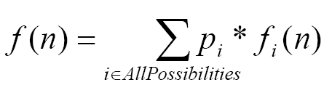
Average Case Analysis

Slide 9
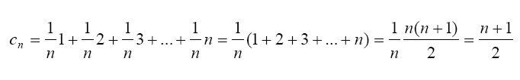
Example: Sequential Search
Number of comparisons
Average case 1: [assume x is in l and equal probabilities x to be in positions 0, 1, …, (n-1)]
c_{n} = O(n)

Slide 10

Example: Sequential Search
Number of comparisons
Average case: [assume probability 1/3 that x is in l and 2/3 it is not; if x is in l equal probabilities x to be in positions 0, 1, …, (n-1)]
)
c_{n} = O(n)
Assumptions are important

Slide 11
Example: Sequential Search
Number of comparisons
Best case: c_{n} = 1 c_{n} = O(1)
Worst case: c_{n} = n c_{n} = O(n)
Average case 1: c_{n} = (n+1)/2 c_{n} = O(n)
Average case 2: c_{n} = (5n+1)/6 c_{n} = O(n)

Slide 12
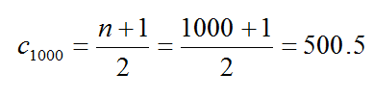

Example: Sequential Search
If n = 1000
Best case c₁₀₀₀ = 1
Worst case c₁₀₀₀ = 1000
Average case first assumption
Average case second assumption

Slide 13
Example: Sequential Search
13

Slide 14
Another example of average case analysis – insertion sort
Alsuwaiyel sec. 1.12.2

Slide 15
Elementary Operation (more formal definition)
An elementary operation is one whose execution time can be bounded from above by a constant depending only on the particular implementation used (the computer, the programming language, and so on).
Thus the constant does not depend on either the size or other parameters of the instance being considered.

Slide 16
Elementary Operations
Assume addition never takes more than t_{a} sec, multiplication – t_{m} sec and assignment – t_{s} sec.
Assume a additions, m multiplications, s assignments
t ≤ at_{a}+mt_{m}+st_{s} ≤ max(t_{a},t_{m},t_{s})*(a+m+s)
Therefore, t=O(a+m+s) - only the number of the elementary operations matters!
To analyze an algorithm it is enough to simply count the number of elementary operations
We can consider an elementary operation to be at unit cost
a constant

Slide 17
Elementary Operations
Most often: comparison, assignment, addition, multiplication
Example of an operation that is not elementary: x^{n} – time depends on n

Slide 18
Basic Operation
Basic operation: an elementary operation that is of highest frequency to within a constant factor among all other elementary operations
Contributes most towards the running time of the algorithm
To analyze an algorithm it is even enough to simply count the number of basic operations (no need to count all elementary operations)

Slide 19
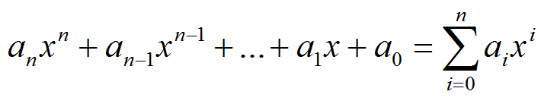

Recall: Example: Calculating the value of a Polynomial
A polynomial of power n:
where
Standard method [≈n²/2 mult.+ n add] O(n²)
Horner’s method [n mult.+ n add] O(n)

Slide 20
Basic operation
In the standard method the basic operation is multiplication because it is O(n²)
In the Horner’ method the basic operation can be either multiplication or addition because both are O(n)

Slide 21
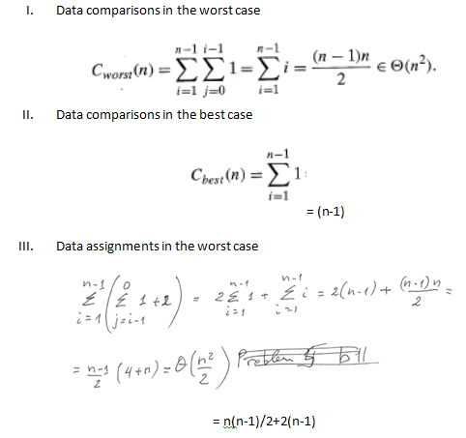
Recall analysis of insertion sort
We can take as basic operation either comparison or assignment; typically for sorting algorithms we choose comparisons.

Slide 22
Recall Analysis of Selection sort
Version 1:
Comparisons = n(n-1)/2
Assignments = 3(n-1)
Version 2:
Comparisons = n(n-1)/2
Assignments = 3(n-1) in worst case; 0 in best case
Basic operation: comparisons

Slide 23
Summary of last two topics
Need for analysis
Empirical and theoretical analysis
Time efficiency, space efficiency, …
Definition of order of growth (Big-Oh) and measuring time efficiency
Theorem – order of growth of polynomial functions
Worst-case, Best-case and Average-case analysis
Elementary operations
Basic operation

